Slide 1

WALKING FORWARD
RESEARCH PROGRAM
Addressing Cancer Disparities Among American Indians in
Western South Dakota
Michele Sargent RN
Program Manager
Walking Forward Program
Avera Research Institute, Rapid City, SD

Slide 2
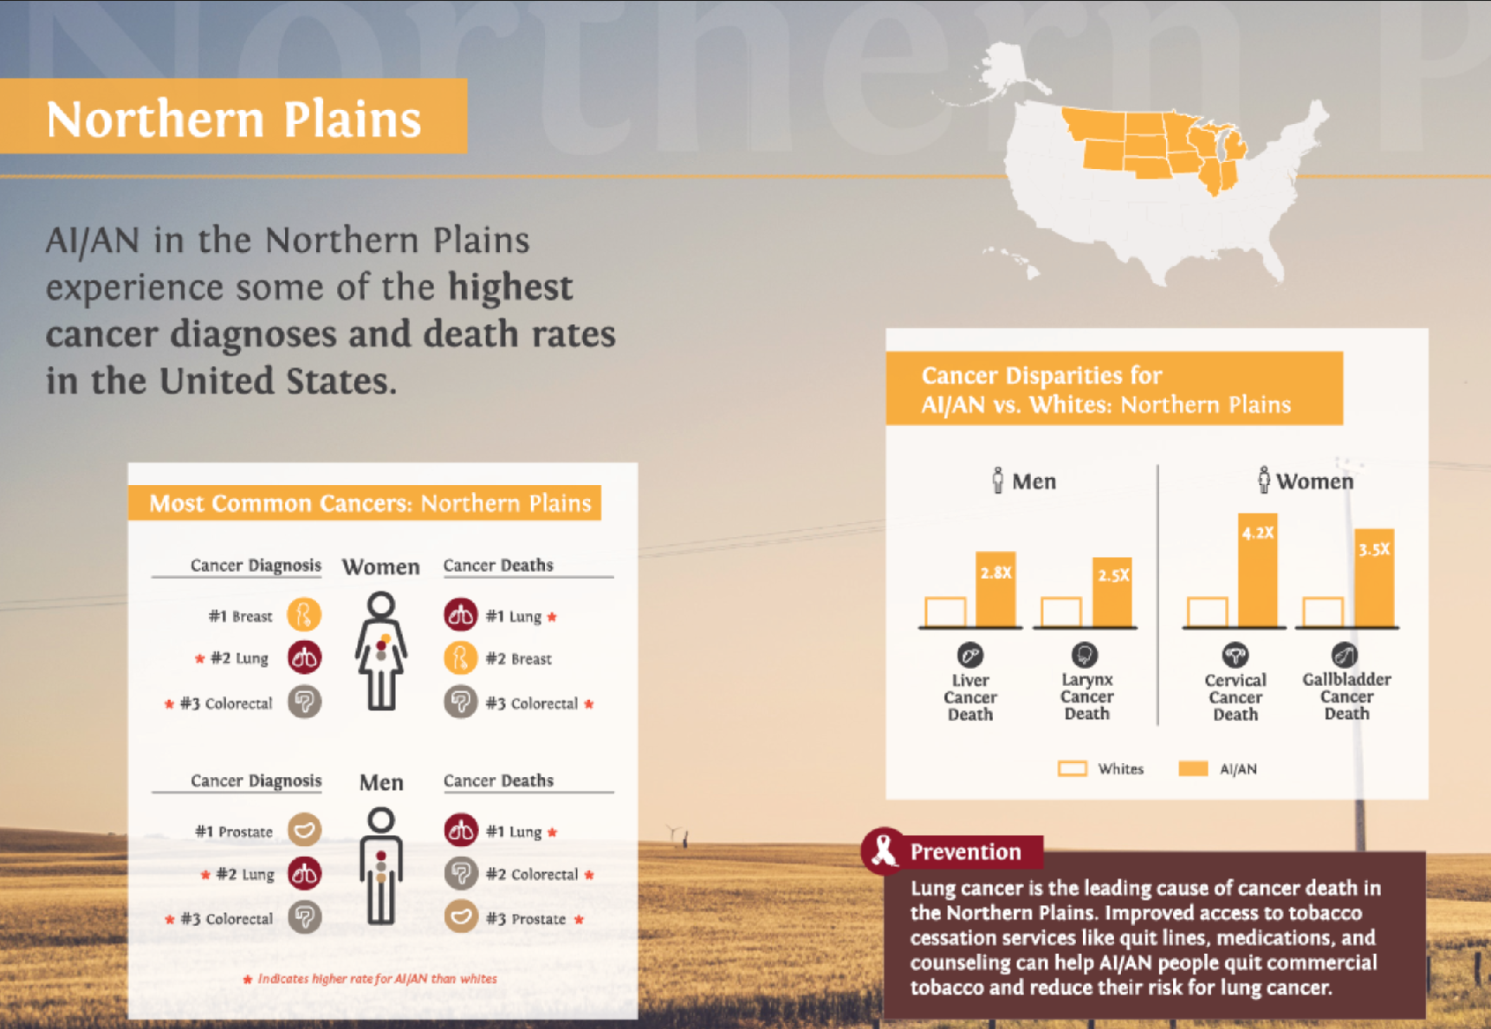
Walking Forward History 2002
Created to address disparities in prevention, cancer care, and outcomes between American Indian and non-American Indian populations.
American Indians present
with more advanced stages
of cancer and experience
lower cure rates.
Notes:
In Dr. Petereit’s RO practice he noticed many of his NA patients were presenting with late stage disease as opposed to his non-NA patients. The data also shows this. When caught at later stages, there is less possibility of long term survival. He wanted to do something to change this.

Slide 3
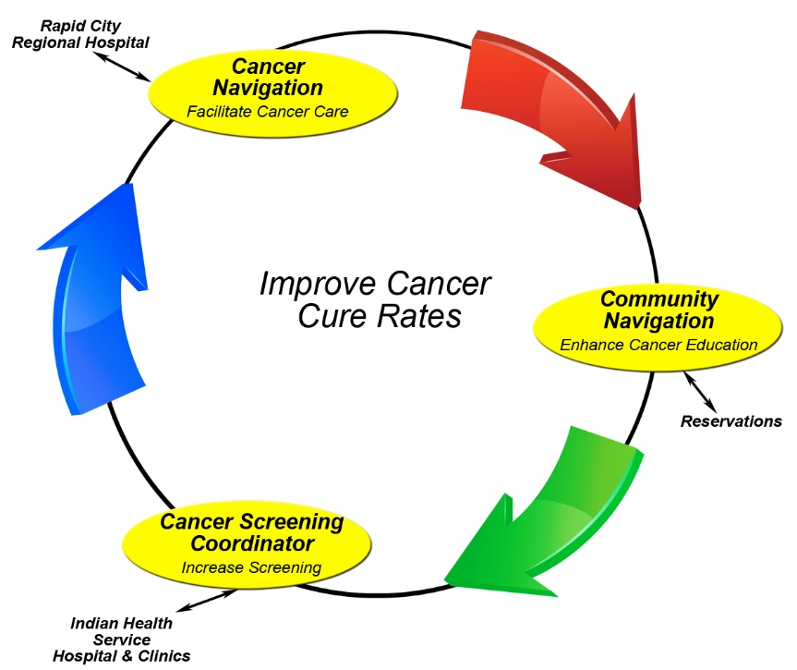
Notes:
Applied for and received 2nd round of CDRP funding to continue our Phase I work and expand upon it as well.
Expanded into more community cancer screening navigation (work further upstream to get community members educated and screened, decrease tx delays…diagnosed with early stage vs. late stage)
Staff located in offices in IHS

Slide 4
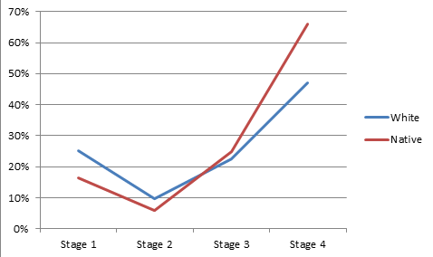
Smoking and Lung Cancer in South Dakota
High smoking rates: State average 20%, 7 counties over 30% (Todd County highest at 41%)
High lung cancer mortality rates:
  American Indian: 95 per 100,000
  Whites: 55 per 100,000
  Northern Plains AIs: highest lung cancer mortality rate in the US
New diagnosis of Non-Small-Cell
Lung cancer 2009-2015 Rapid City
Notes:
We started looking at a potential lung cancer screening study, due to several factors:

Slide 5
Increasing Lung Cancer Screening for High- Risk Smokers in a Frontier Population 2017
Research Question:
  Will provider and/or individual level interventions increase LDCT lung cancer screening among high-risk smokers living in western South Dakota?
Project Goal:
  To increase lung cancer screening rates by educating primary care providers and their clinic staff as well as community members in western South Dakota.
Aim 1: Screening Awareness
  Build on previous research to improve provider and individual awareness of LDCT lung cancer screening
    Initial follow-up surveys at baseline and 6 months
Aim 2: Evaluate the efficacy of two interventions with PCPs and community members to increase awareness of LDCTs
  Main outcome measure: number of LDCTs completed
Aim 3: Policy Symposium and Lung Health Forum
  Engage community members, state and tribal leaders, primary care providers
  Develop sustainable, evidence-based, culturally- and regionally-appropriate practice and policy recommendations

Slide 6
Provider Workshops/CME sessions
- 19 clinic sites completed
- Provider accrual 135
Community Workshops/Education sessions
- 1000 participants
- 25 different communities throughout western SD
Additional funding provided by the Irving A Hansen Memorial Foundation
- Funds to pay for LDCTs ($152,500)
- 500 LDCT referrals have been obtained with 390
completed

Slide 7
Provider Intervention
Baseline/Pre-edu. Survey
LDCT Knowledge:
36.7% - had not previously received info about LDCT lung cancer screening
71.1% - had not received education/continuing education about LDCT lung cancer screening
LDCT Referrals:
57.95% - had referred patients for LDCT in the past
  42% had not

Slide 8
Provider Intervention
6-month follow-up survey
      70.5% had referred patients for LDCT in the last 6 months
      51.4% - referred 1-5 patients
      28.6% - referred 6-10 patients
      5.7% - referred 11-15 patients
Screening Referrals Pre-Provider Intervention | Screening Referrals Post-Provider Intervention
57.95% | 70.5%

Slide 9
Community Intervention
Baseline/Pre edu. Survey
Participants (N-955):
  Median age – 44
    44.1% - male, 55.8% - female
  Race:
    90.9% - AI/AN
    4.7% - White
    1% - African American
    2.6%- other
  Ethnicity:
    3.0% - Hispanic, Latino or Chicano

Slide 10
Community Intervention
Baseline/Pre-edu. Survey
LDCT Knowledge:
  92.9% - had not previously received info about LDCT lung cancer screening
  96.4% - had never had a provider suggest they have a LDCT for lung cancer screening
  97.6% - had never had a LDCT for lung cancer screening
Lung Cancer Screening Beliefs:
29.1% - stated if they found out they had lung cancer after LDCT, they would not or were not sure if they would get treatment.

Slide 11
Community Intervention
Baseline Survey – Post Education
  82.5% - had excellent or good understanding of lung screening after education session
  49.1% - were likely or very likely to get a LDCT based on what they learned
  90.0% - said lung cancer screening is important or very important
  98.3% - likely or very likely to
  recommend the education to
  someone else
Increase in LDCT completion of 7.2%

Slide 12
LDCT Patient Intake Survey
Completed by patient at LDCT appointment intake surveys completed - 2829
Reasons patients reported seeking LDCT
  88% - provider recommended

Slide 13
LDCT Patient Intake Survey
Of the 88% of patients who sought LDCT because their provider recommended it:
  46% of the providers had attended a WFP edu. session
  73% of the providers work at a clinic that hosted a WFP edu. session

Slide 14
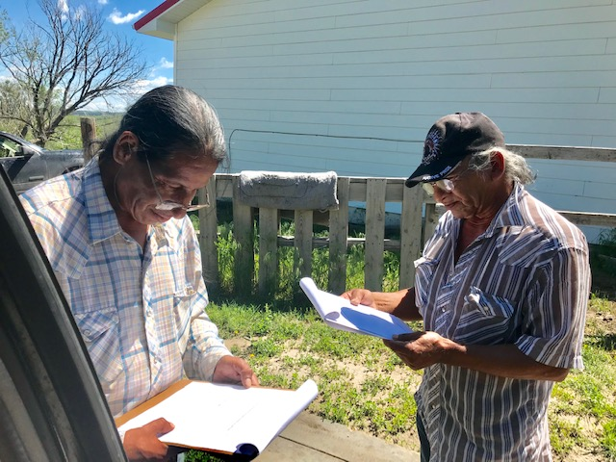
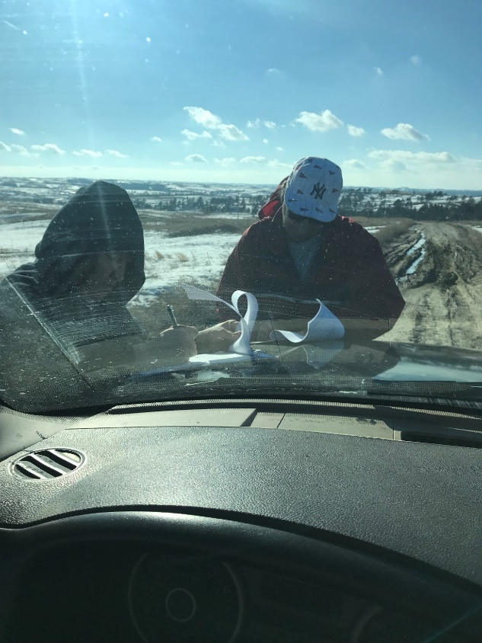
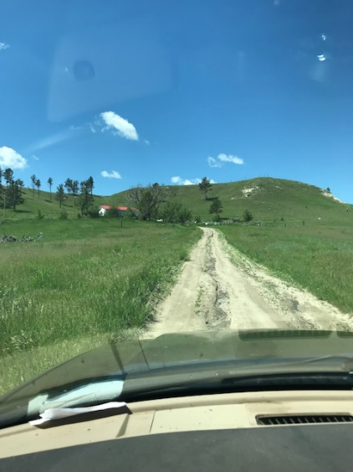
Overcoming Challenges

Slide 15
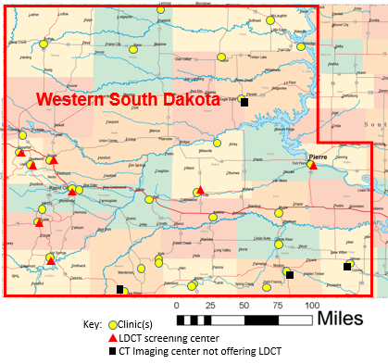
Challenge:
Limited
access to screening LDCT
2 X 2 Design
Intervention: | Study Groups:
 | A | B | C | D
Provider | No* | Yes | No* | Yes
Individuals | No* | No* | Yes | Yes
*delayed intervention based on study findings
Notes:
It was a 2x2 design with 4 study groups…

Slide 16
Barriers To Care
Community
Rural with limited access
Distance to imaging
Lack of transportation, childcare, support
Community members uninsured and reliant on IHS contract care
Fatalistic frame of mind
Low life expectancy

Slide 17
Barriers To Care
Provider
Rotating providers
Not utilizing LDCT as standard of care for screening
IHS providers not referring out
Lack of provider and staff training and credentialling
Additional
Pandemic challenges – reservations communities locked down

Slide 18
Lessons Learned
Be prepared to influence process, EMR tab for fast referral
Plan and preparation in place to assist community members through financial resources to mitigate travel and access barriers
Implementation Science, requires patience, time and trust
Plan early for a sustainability strategy
Community based participatory research (CBPR)
  Navigation staff are tribal members living on the reservations
  Engage tribe early, often and consistently
Flexibility
  Program strategy adjusted for community needs (COVID)
  Unintended challenges produce creative solutions and partnerships
  Adapt to needs , offer/provide resources when needed ie provider credentialing connections
Many necessary ongoing collaborations: Healthcare, policy, tribal, IHS, both within and outside of South Dakota
Essential that PI is part of the community/region with dedicated research time (funding)
Notes:
Essential to work closely with the community to let them steer the research being done. Engage them from the very beginning to find out if this is the type of project they would like done or if they have other needs. Work with them throughout the life of the project with CABs, updating Tribal Health, etc.
One way we have done this from the beginning of WF is to employee community staff who are Tribal members who live in their communities, and will then work for our project in those communities.
Website of little value
various reasons: other good online resources developed about the same time when LDCT was really starting to be pushed
PCPs are just too busy in rural communities

Slide 19
Why Navigation ?
Navigation Increases:
Access
Resources
Screening completion
Follow up across continuity of care
Compliance to treatment
Knowledge and understanding
Collaborations
Process improvements
Trust

Slide 20
Thank you
Michele Sargent RN
Program Manager
Walking Forward Program
Avera Research Institute,
4904 5th Street 1C
Rapid City, SD 57701
605 791 1724
https://www.avera.org/research-at-avera/research-institute/walking-forward/

