Slide 1
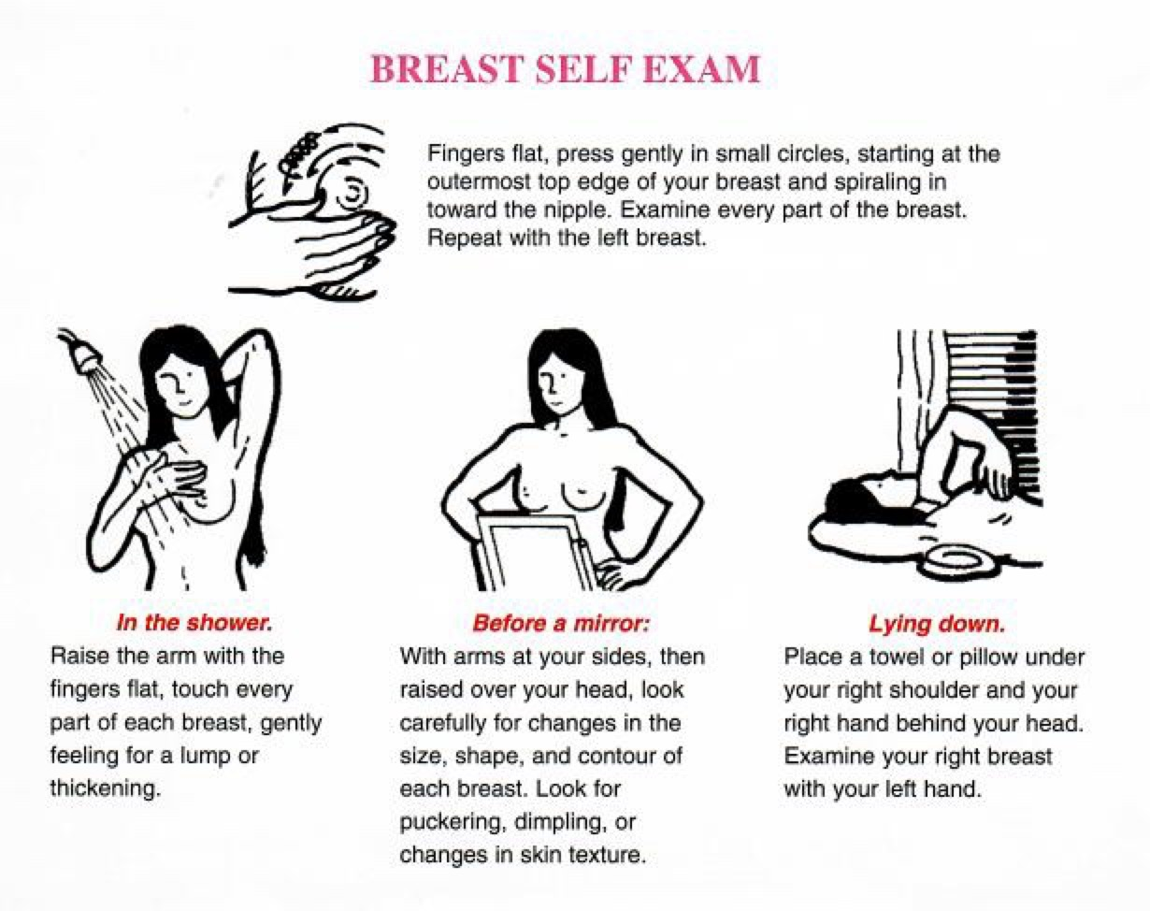
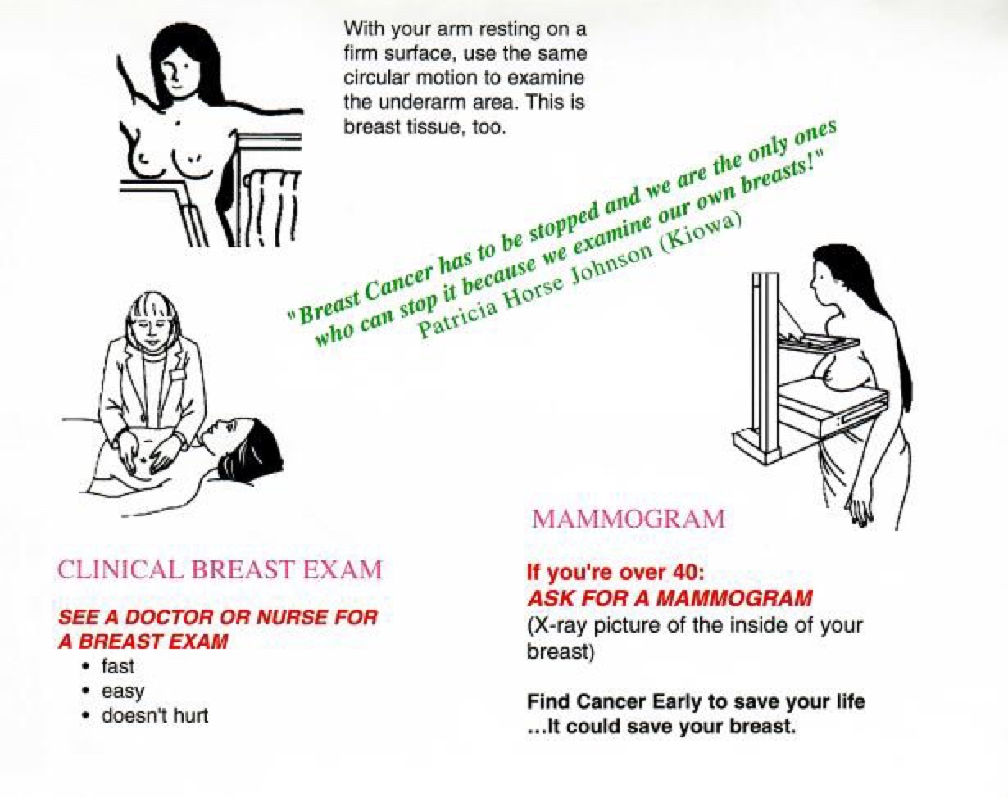
Although national guidelines no longer include BSE, it is important for you to know how your breasts feel and change; share this knowledge with your provider. Linda B

